Slide 1
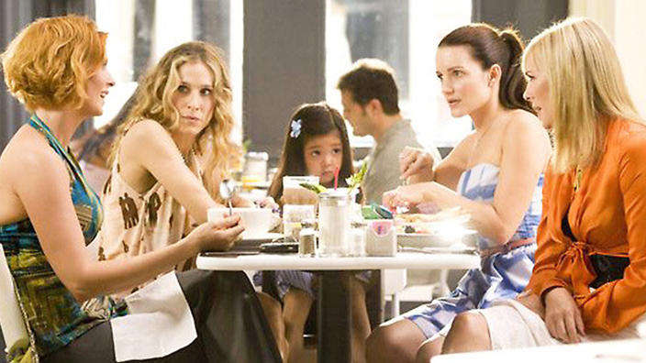
Prospecting - Doing it Right
Stephanie Ng
Supervising Coordinator

Slide 2
Prospecting
“The original meaning of prospecting is the search for mineral deposits or gold mining.”
In this case, prospectors are people who search for gold, identifying places where it can be found. Once discovered, they sit by the river and check mounds of dirt for just a few specks of gold.

Slide 3
What is Prospecting
Like mining, we network/socialize to expose ourselves to get to know people. Through conversations, experiences and building the relationship we find that GOLD.
The art of prospecting is the art of making friends with a skill of identifying they want in life.

Slide 4
PROSPECTING IS NOT AN EVENT! IT IS A PROCESS Prospecting + WHY = Coffee Meeting

Slide 5
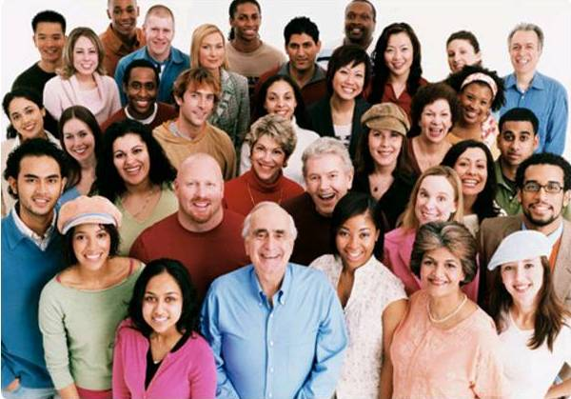
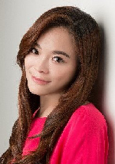
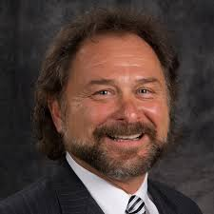
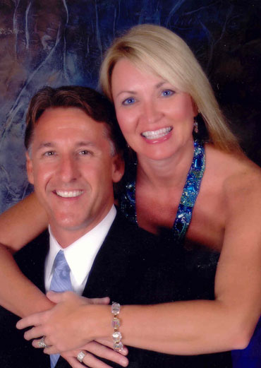
Concept of Prospecting
POSSIBLITIES
Build Social Currency. Increase Net worth by increasing social Currency. Keep Building Friends and sorting as you go along.
RECRUITING
Friend/Family
Networking
Keep The FUNNE FULL!
PROSPECTING
Social Media
Work
Through the process, and the sorting process the “nuts” will appear.
The NUTS

Slide 6
Out of 1095 People = How many will ask you what you do?
1 Day = Meet for Coffee
1 Week = 7 Coffee Meeting
4 Weeks = 28 Coffee Meeting
1 Year = 365 Coffee Meeting
3 Year = 1095 Coffee Meeting

Slide 7
Needs & Skillset of a Good Prospector
Appearance and Mannerism
Posture
What is it? / What do you do? /Your Why
Business card
Website
Database List to update
Professional Appointment Setter

Slide 8
If you do it Right………..!
POSSIBLITIES ARE EVERYWHERE

Slide 9
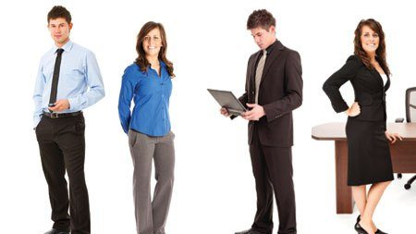
Appearance and Mannerism
Appearance
How we look creates an impression and an opinion when someone meets us
How we like someone to view our business is how we should dress.
Dress appropriate to the event.
Mannerism
Our actions matters
Be polite
Be courteous and aware of surroundings
Culture and Ethics plays a part
Show Respect is important

Slide 11
Dress Code

Slide 12
Tips on Prospecting
Dress appropriate to the environment
Come with a SMILE
Topic of discussion is NEVER YOU!
Know about them ONLY!
Objective:
FIND OUT WHAT THEY WANT
GIVE THEM WHAT THEY WANT BY BEING THE PROBLEM SOLVER
LET THEM LEAD YOU TO THEIR PEOPLE
Set the Appointment

Slide 13
Conversational Marketing
Smile. Be Friendly
Build a Connection
Find some common ground that you have either similar interest or connection or things you do.
LISTEN
Let them talk - NOT YOU! Use power words to keep them going like “wow”, “Really ?”, “You got to be kidding me?”, “Awesome”..
Gather information. Use FORM + THEME or FORMHD
F: FAMILY O: Occupation R: Recreation M: Money
THEME: Backup Plan, Health, Dreams, Tax, Brokerage..
4. Open Mind
Use concept like : Golden Goose/Cash Flow Quadrant to help them see
SOMETIMES – the conversation doesn’t lead you to an opening. When you do #3 and #4
It is OK! Keep the contact. May not be the right time or right individual or you may need to build up a relationship.

Slide 14
Conversational Marketing
5. Approach:
Use this only if you feel like saying or introduce a product or the business…
Step 1: Do you keep your options open? (wait and listen)
If YES – goto step 2
If NO – Change topic and move on
Step 2
If I can show you a way…(prospect challenge)…. Is there any reason why you won’t …(try the product/get more information)….
If I can show you a way …(prospect challenge)… Would YOU.…(try the product/get more information)…
6. Next Step
Set the Appoint
Set a time to call or meet for coffee

Slide 15
Be Ready to Answer
“What DO YOU DO?”
“What is it?”

Slide 16
Power Statement
WHAT DO YOU DO ?
I’m a _____ and I own _____
example
I’m a teacher and I own an online franchise.

Slide 17
Purpose!
Have their interest?
When they are asking too many questions, it is time to set the appointment.
“Everything else is hard to explain, can we get together? Which day works better for you, Monday or Tuesday?”

Slide 18
Example of What do you do
I teach people how to make a lot of money online
– Liz Webber
I help people create an ageless lifestyle with wellness solution.
– Jacki Blasko
I teach people how to make a lot of money online with a new concept call the UnFranchise.
– Jim Winkler

Slide 19
Power Statement
WHAT IS IT?
COMPANY ANSWER
A GLOBAL PRODUCT BROKERAGE AND INTERNET MARKETING COMPANY THAT SPECIALISES IN ONE-TO-ONE MARKETING

Slide 20
Example of WHAT IS IT?
It’s a way to make a lot of money online.
– Liz Webber
It’s a product brokerage and internet marketing company that helps people turn their spending into earning and create shopping annuity.
– Jacki Blasko
It’s call the Shopping Annuity, Have you heard of it? Basically I help people take money they already spending on every day stuff and turn it into an investment that pays them on an ongoing basis.
– Colton Whited
We are really a hybrid between franchising and internet marketing and traditional business. We take the best of each to create an entirely new concept called the UnFranchise.
– Jim Winlkler
Have you every heard of the Shopping Annuity? It’s a way of taking the dollars you are already spending and putting them into an investment for yourself. I can’t believe you have never heard of it.
– Ke and Joe Gerard

Slide 21
YOUR WHY
2 Minute Commercial
This is a testimonial of the real reason WHY you are doing this business accompanied by an appealing description of the business
I was sick and tired of living month to month on a salary that never seemed to grow. I started this business to create a second income to take the stress out of the month
I started my UnFranchise® business to establish my children’s college fund

Slide 22
How do you use it?
Candidate : What do you do?
UFO: I am an ___________ and I own and online Franchise
Candidate : What is it?
UFO: Its shop.com. Have you heard of it?
Candidate : No. What do you sell?
UFO: Let me send it to you. Can I have your email? ( PAUSE) Did you get it?
Candidate : Yes.
UFO: Do you shop online or like to save money or cash back while shopping?
Candidate : Definitely.
UFO: Let me send you a video, take a look at it. Its about savings on the site.
Candidate : Sure
UFO: Will it be ok that I check in with you, after you watch the video to have your input on the site?
Set a time to call or meet for coffee

Slide 23
Is there any reason between now and then that you would change the appointment?
There are 2 kinds of person in the world, those that are honorable and those that are not, which are you?
I am sure you are an honorable one.
Firming up the Appointment

Slide 24
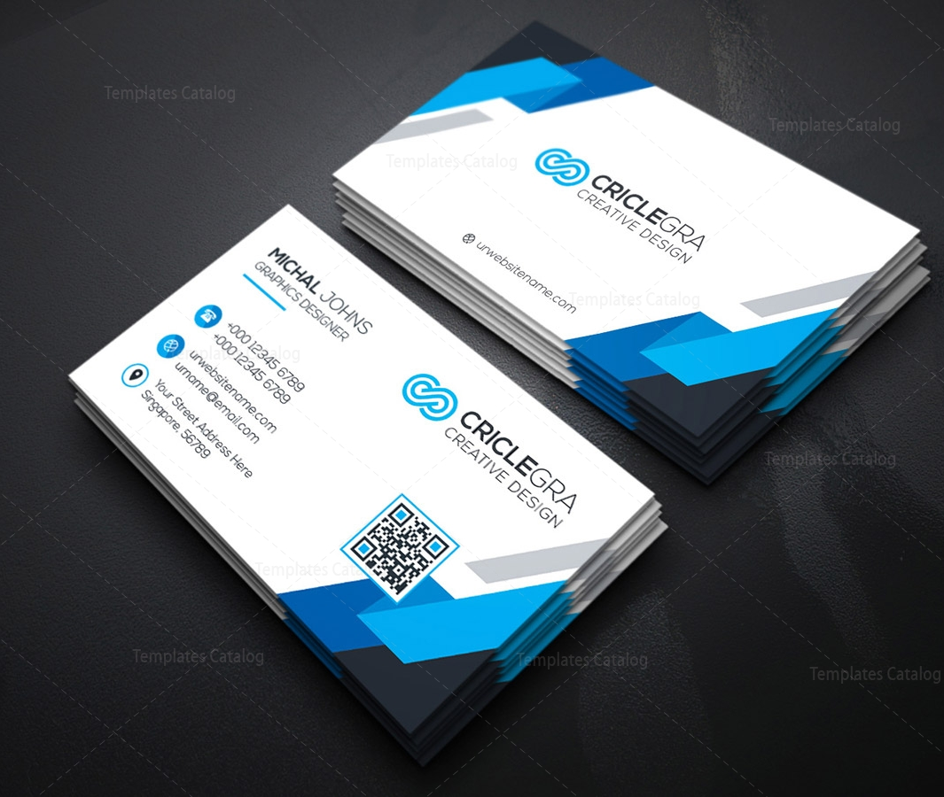
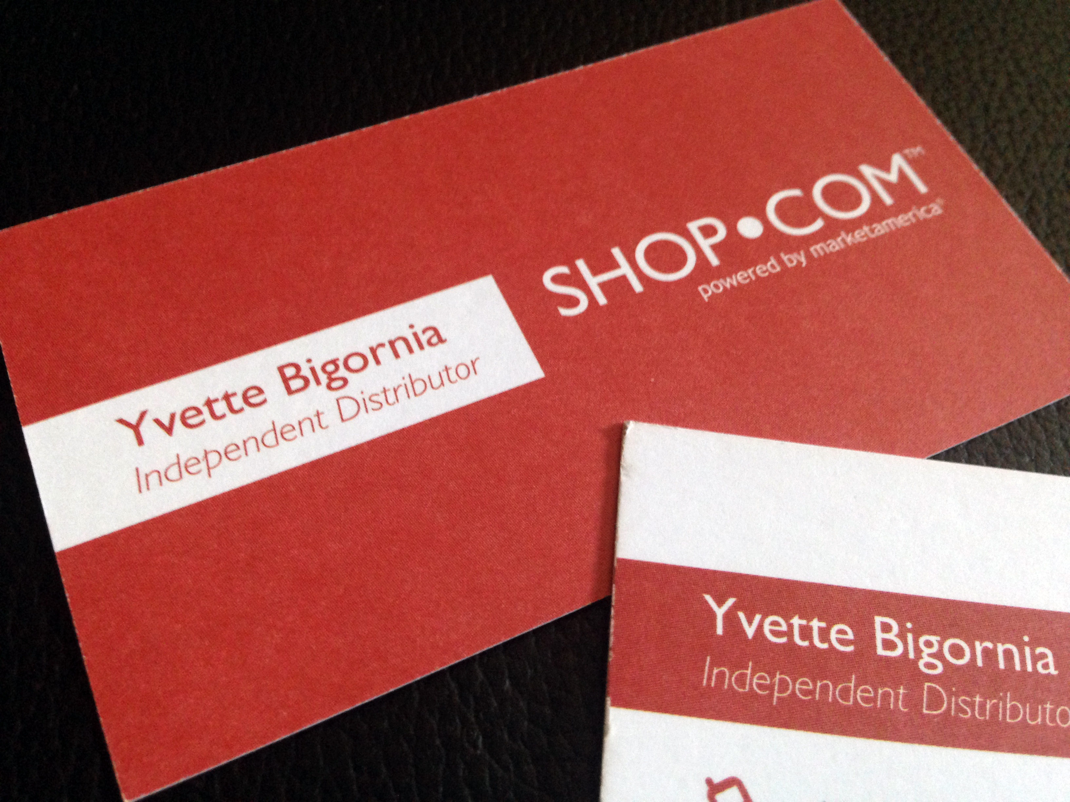
Business Card

Slide 25
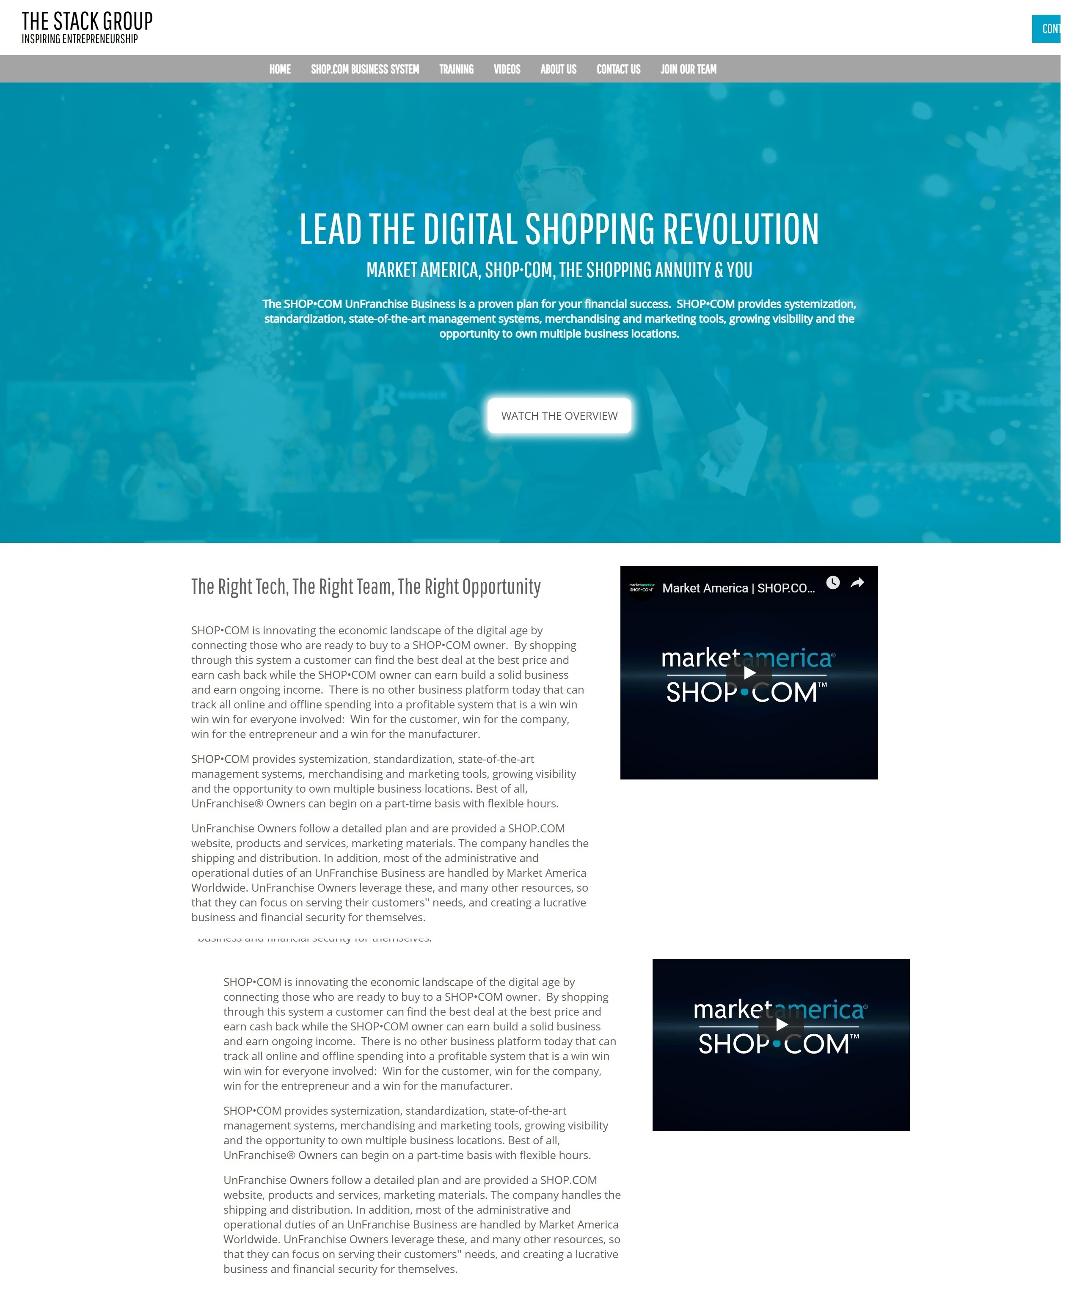
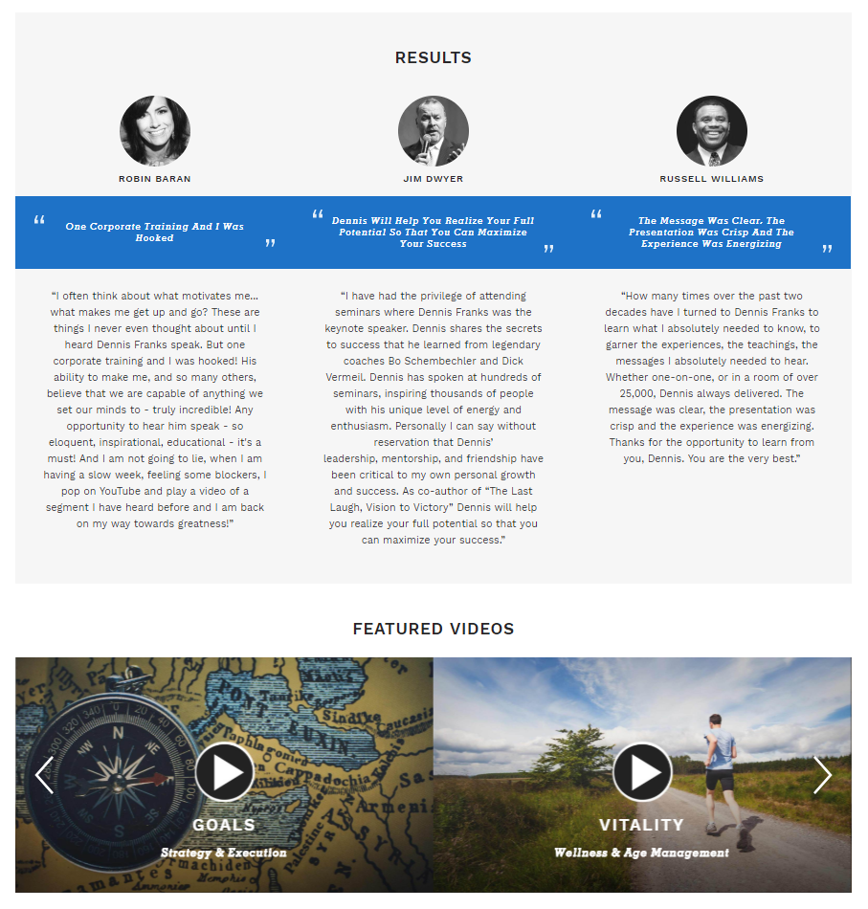
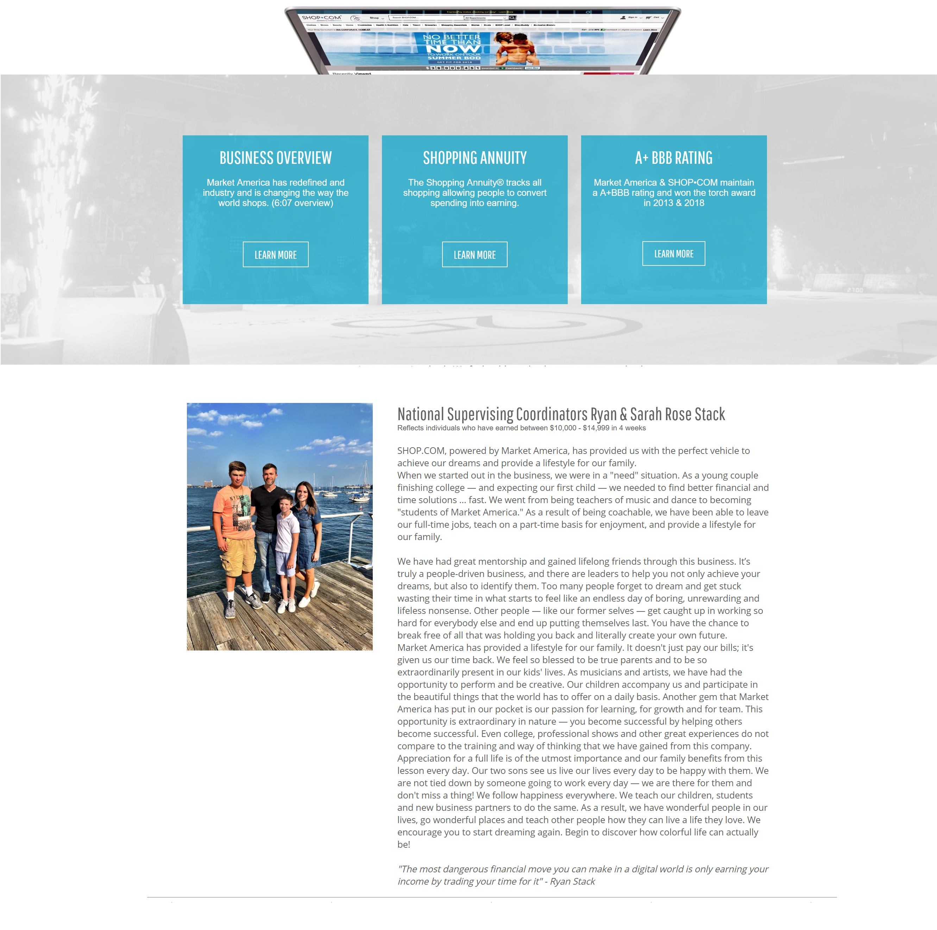
Professional Website/Introductory Page

Slide 26
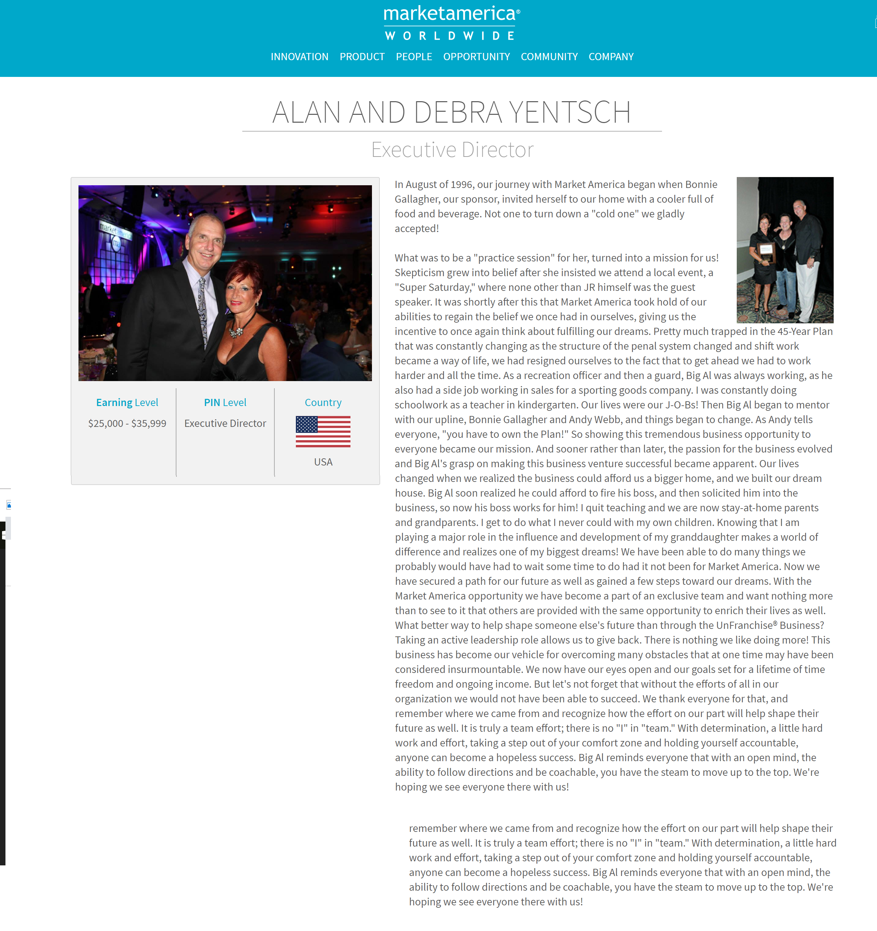

Slide 27
Improving Skillset of Prospecting
Call Workshop/Text
Group Networking
Group Social

Slide 28
Prospecting - Doing it Right
Stephanie Ng
Supervising Coordinator

